Slide 1
Vision Based Volumetric Flow Measurement for wastewater and Storm water Networks
SeyedMojtaba Noghabaei
North Carolina State University

Slide 2
Outline
Overview
Neural net
Results
Works to be done

Slide 3
Overview
Train a Neural Net for predicting pipe or junction overflows

Slide 4
Overview
Plan is to run SWMM (Storm Water Management Model) for a number of different precipitation inputs and then train a machine learning algorithm to predict overflow at each pipe or junction based on precipitation
Then we will connect our machine learning model to the MR so that we can see predicted overflow in real-time using different precipitation inputs based on rainfall data

Slide 5
Research Method
Data from SWMM
Neural net
Predicted Overflow

Slide 6
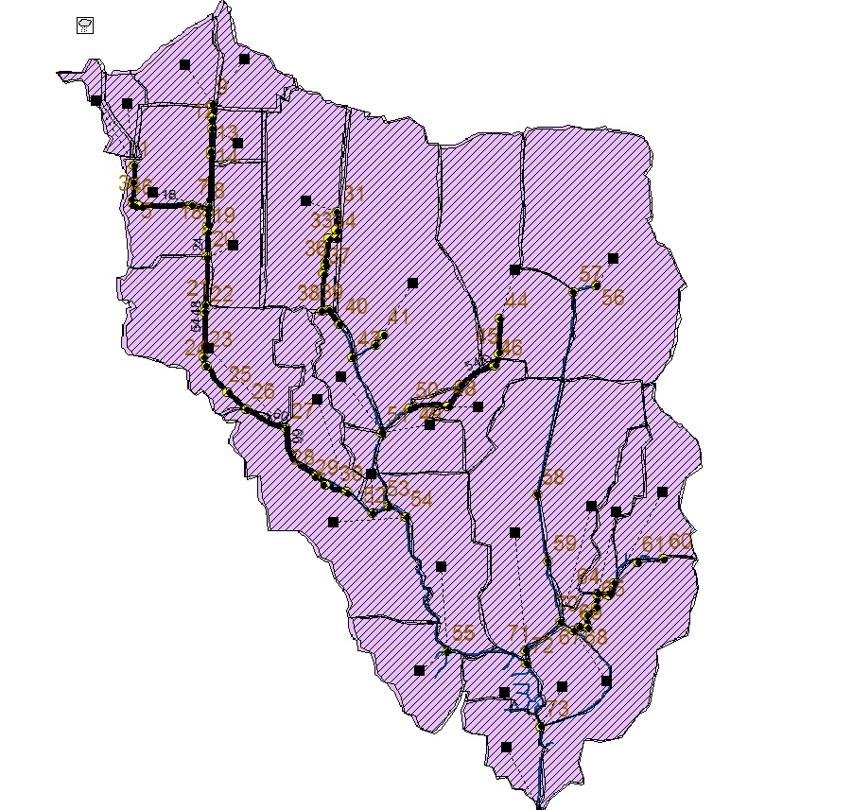
Phase 1: SWMM model data generation
Run SWMM for a number of different precipitations and find pipes or junctions with overflow problems

Slide 7
Phase 1: SWMM model data generation
5 minute sampling hydrographs
SWMM
Precipitation Hydrograph
Predict Overflow

Slide 8
Phase 2: Which Precipitations Cause Overflow Problems
Precipitation hydrograph
Precipitations with high peak

Slide 9
Make The Precipitation Shape More Simple
Simplify hydrograph with four numbers

Slide 10
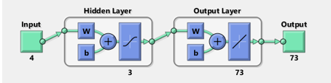
Machine Learning
Neural net fitting
4 inputs for each hydrograph
73 outputs for each junction in network(1 or 0)
3 hidden layers

Slide 11
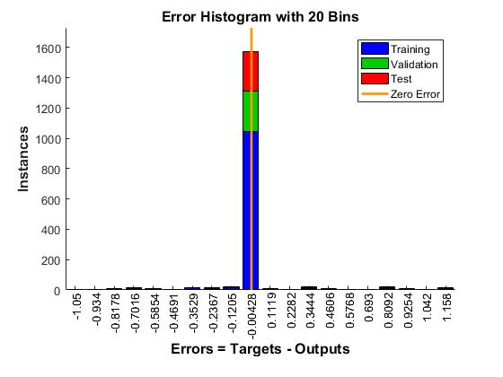
ML Results
70% training
15% validation
15% test

Slide 12
ML Results
MSE = 4.12e-2
R = 9.06e-1
Mean Squared Error is the average squared difference between outputs and targets. Lower values are better. Zero means no error.
Regression R Values measure the correlation between outputs and targets. An R value of 1 means a close relationship, 0 a random relationship.

Slide 13
ML Results
Same overflow pattern over most of the precipitations
Outputs are 1 and 0
Only 4 inputs

Slide 14
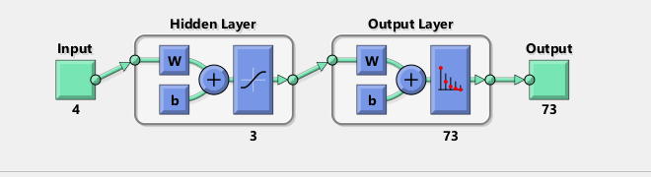
Machine Learning
Neural net pattern recognition
4 inputs for each hydrograph
73 outputs for each junction in network(1 or 0)
3 hidden layers

Slide 15
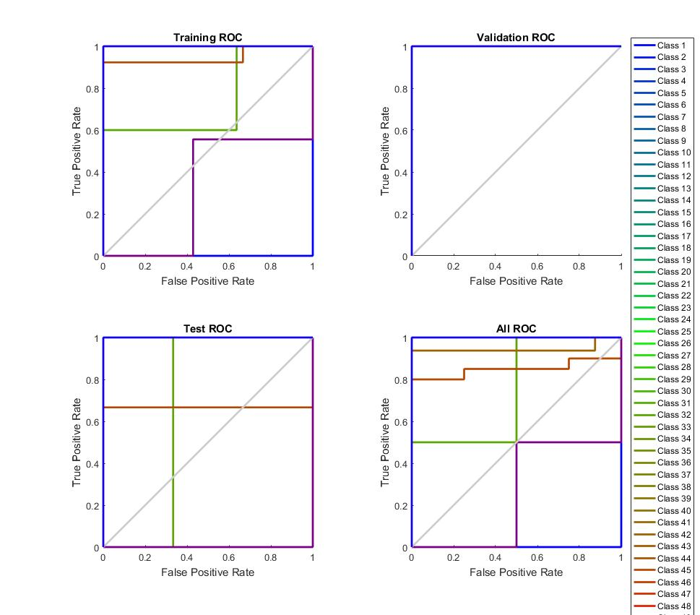
ML Results
70% training
15% validation
15% test

Slide 16
ML Results
CE = 7.39
%E = 1237.5
Minimizing Cross-Entropy results in good classification. Lower values are better. Zero means no error.
Percent Error indicates the fraction of samples which are misclassified. A value of 0 means no misclassifications, 100 indicates maximum misclassifications.

Slide 17
ML Results
Results were not satisfactory because of huge number of outputs
Increasing the dataset and using more hidden layers (deep neural net) might be helpful

Slide 18
Works to be done
Show the perditions using ML in MR

Slide 19
Thank You

